Slide 1
‎Exploratory Data Analysis
2022 Semester2
Group 29
Zhiyuan Chen
Zhi Hern Tom
Ya Cho
Suyi Jiao
Zhuoling Chen

Slide 2
Preliminary questions
In patients having open heart surgery after they have left the operating room:
1. what is the last measured red cell (expressed as hemoglobin(Hb)) before the first blood transfusion is given?
2. when the first act of blood transfusion is performed, how many units of blood(red cells/paced red cell) are given?
3. what is the last Hb before a blood transfusion is given in men compared with women?
4. what is the difference between the first Hb after the blood was given and the last Hb before the blood was given ?
5. what is the difference between the first Hb after a single unit of blood was given and the last Hb before the blood was given in men compared with women ?

Slide 3
Preliminary questions
For condition:
Patient having open heart surgery: cohort of patient with CABG
After they have left the operating room: time after the latest outtime of careunit = 'Cardiac Surgery’
For corresponding tests:
Hemoglobin(Hb) : the measured hemoglobin(from lab table in mimic_hosp)
Blood transfusion : packed red blood cell (from inputevent table in mimic_icu)

Slide 4
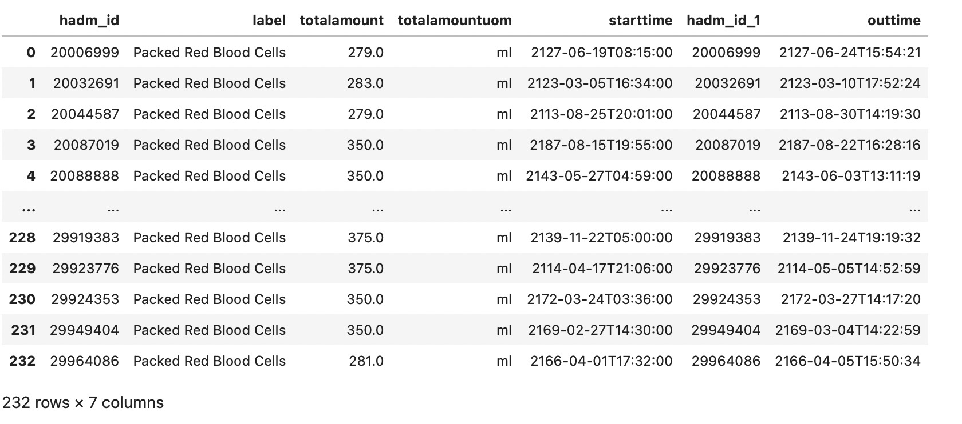
EDA- first blood transfusion
Q2. when the first act of blood transfusion is performed, how many units of blood(red cells/paced red cell) are given?

Slide 5
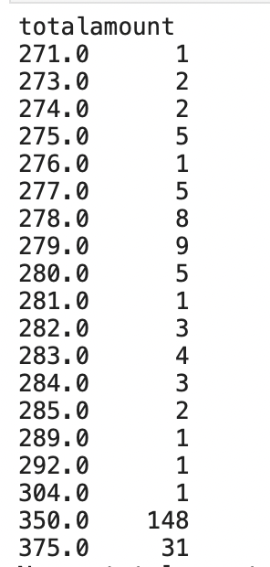
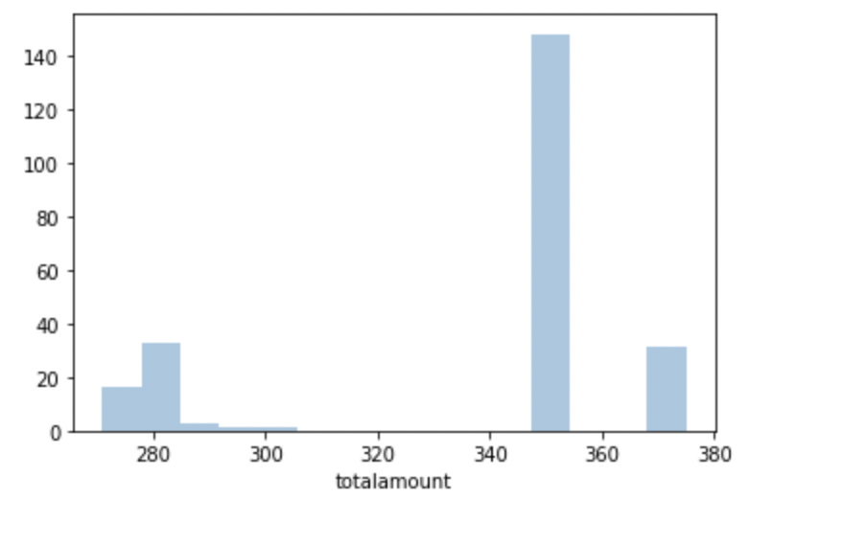
EDA- first blood transfusion

Slide 6
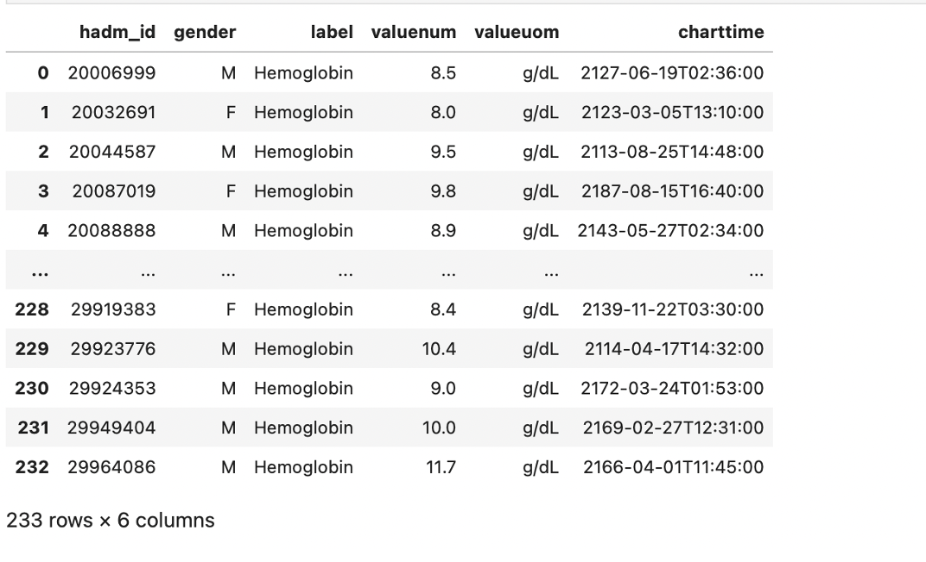
EDA- last measured hemoglobin
Q1. what is the last measured red cell (expressed as hemoglobin(Hb)) before the first blood transfusion is given?

Slide 7
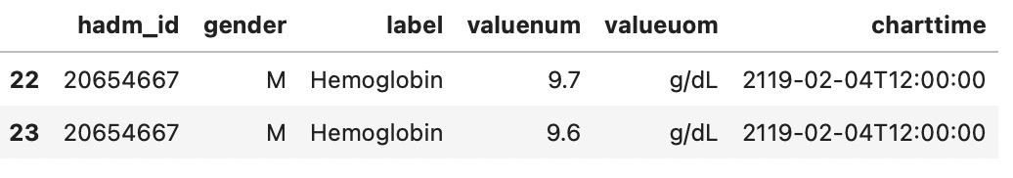
EDA- last measured hemoglobin

Slide 8
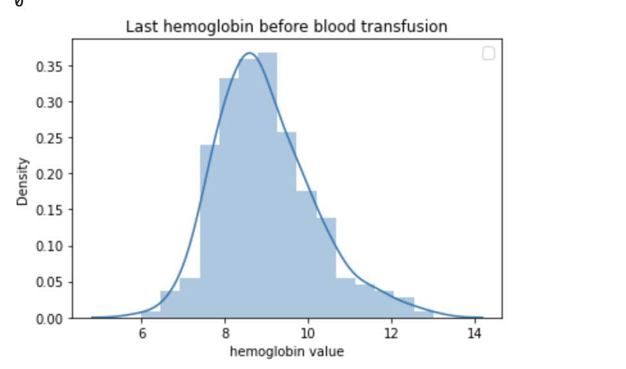
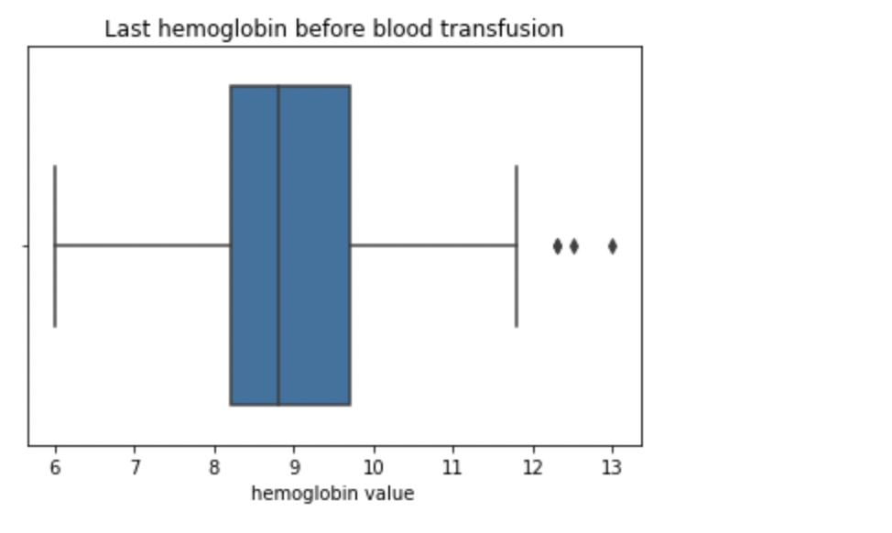
EDA- last measured hemoglobin
Q1. what is the last measured red cell (expressed as hemoglobin(Hb)) before the first blood transfusion is given?

Slide 9
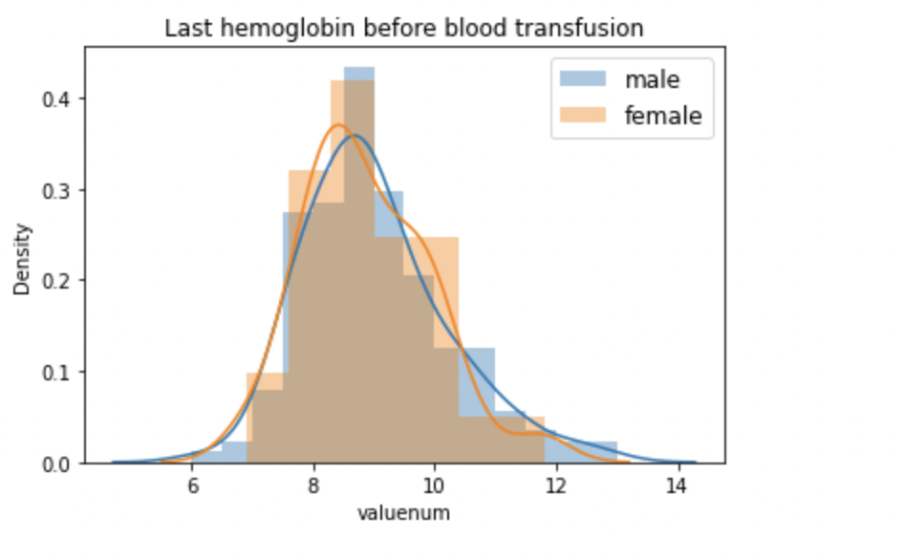
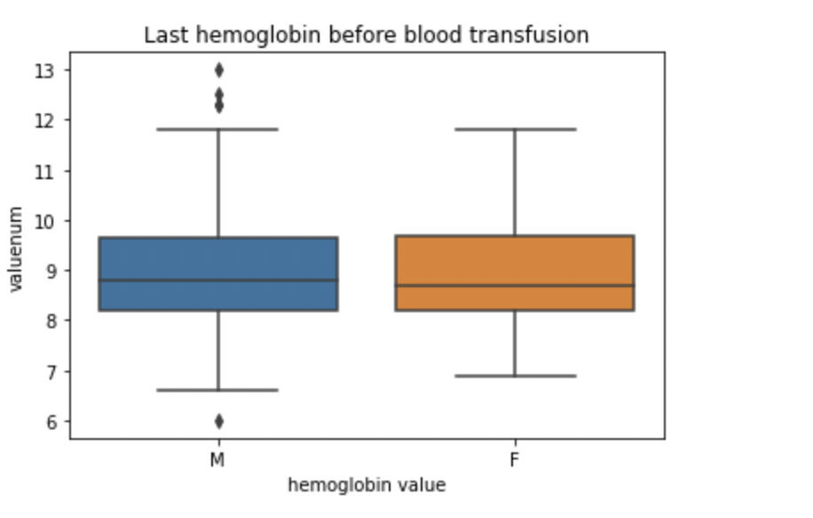
EDA -last measured hemoglobin
Q3. what is the last Hb before a blood transfusion is given in men compared with women?

Slide 10
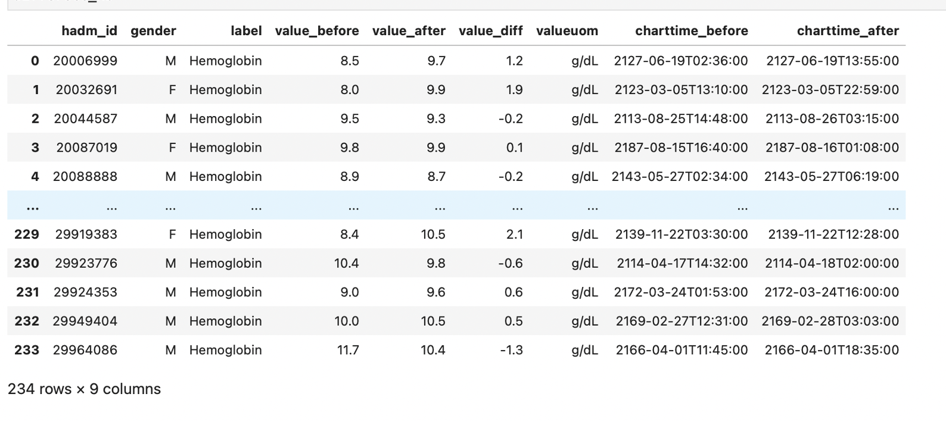
EDA- difference between hemoglobin
Q5. what is the difference between the first Hb after the blood was given and the last Hb before the blood was given (in men compared with women) ?
Notes:
The query result for the question what is the difference between the first Hb after the blood was given and the last Hb before the blood was given (in men compared with women) is shown on the screen:
Value_before is the last Hb value before the blood was given;
value after is the first Hb after the blood was given;
value_diff is the value_after minus value_before.
Charttime_before is the time the value before measred; and
Charttime_after is the time the value_after measures
there are 234 rows and 7 column,
Normally Each row is record for one patient, but there are two exception. Actually there are 232 patients

Slide 11
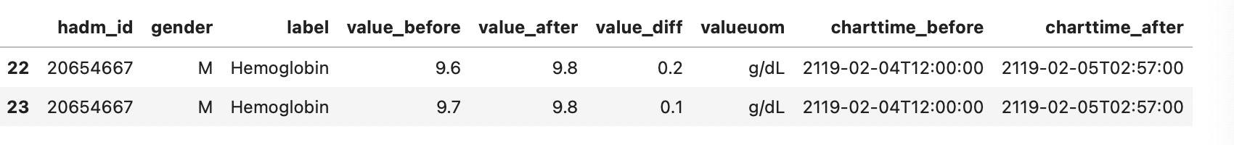

EDA- difference between hemoglobin
Notes:
Here is the two exceptions. for this two hadm_id, we can find there are two records related to each of them. For first case, we can find the patient measured value_before twice at the same time with two different value. For second case, we can find the patient measured value_after twice at the same time with two different value. This two patient casuesd our dataframe contain 234 rows although we only have 232 patient. We directly using the dataframe with 234 rows to draw the data analysis plot

Slide 12
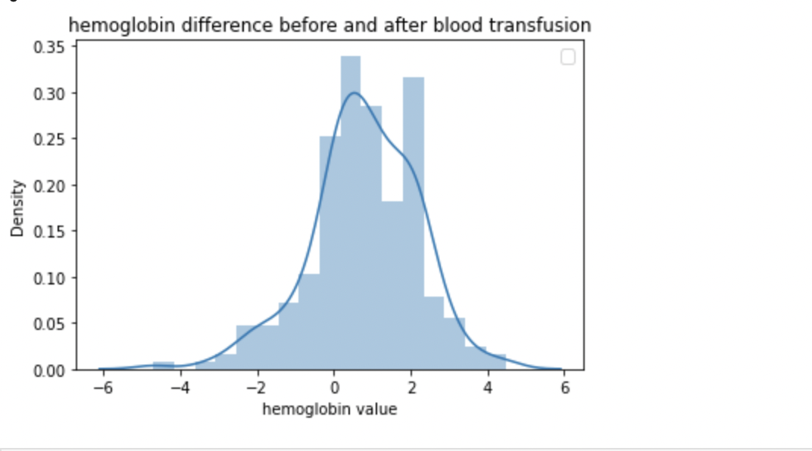
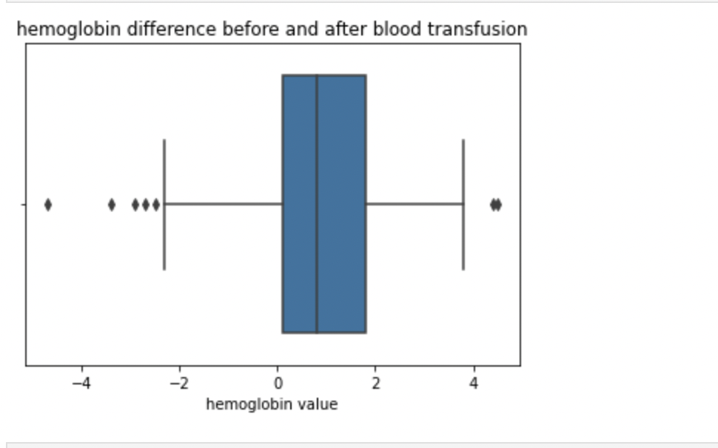
EDA- difference between hemoglobin
Q4. what is the difference between the first Hb after the blood was given and the last Hb before the blood was given ?
Notes:
Next,we drew the distribution plot and boxplot for the hemoglobin difference.
The distribution plot shows the value of hemoglobin difference can taken value from -5 to 5 and get relative high density at around 0 and 2
From boxplot, we can see theIQR(interquartile range) of hemolobin located between 0 and 2 . More than 75 % of the difference between HB is positive.
Its Median is around 1. from both plot, we can find, even the blood was given , the amount of hemoglobin still decrease for many patients 25%

Slide 13
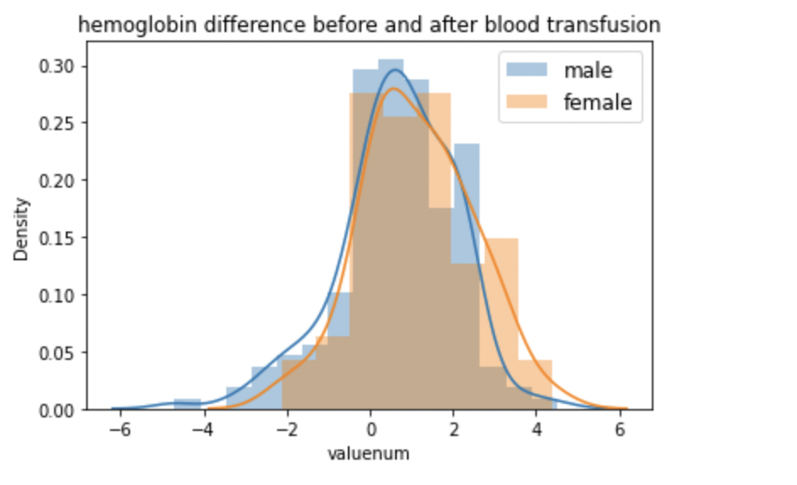
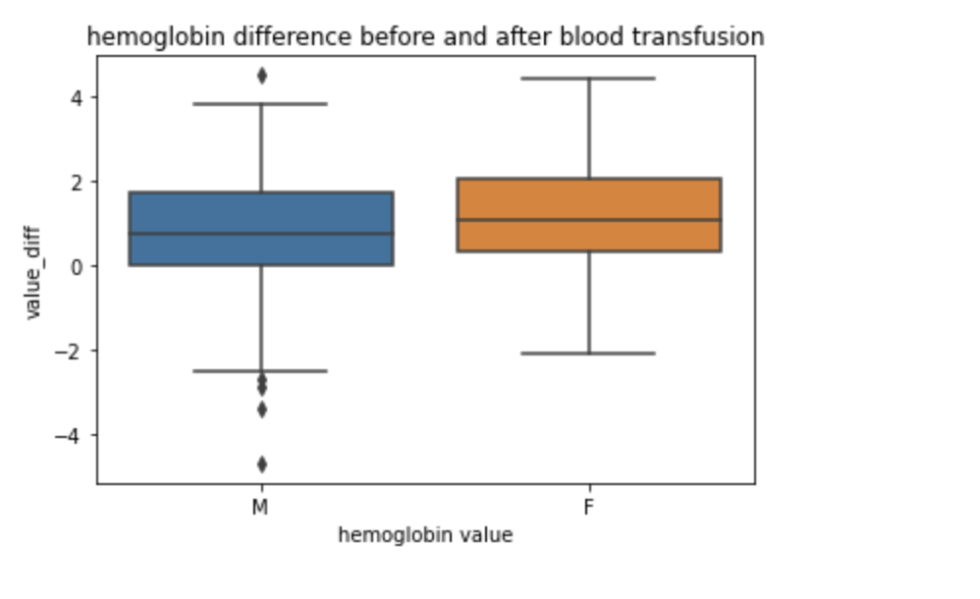
EDA- difference between hemoglobin
Q5. what is the difference between the first Hb after a single unit of blood was given and the last Hb before the blood was given in men compared with women ?
Notes:
When adding gender factor into consideration, from distribution plot , orange part represent female while blue part represent male, it looks like they have similar shape.
This difference caused by gender is easier to be detected from the boxplot, we can find the boxplot stands for female is slightly higher than that of male, which means the difference of hemoglobin for female is slightly larger than that of male. and for male, there are more outliers.
Another point I want to mention. Is In the question it ask the difference HB after a single unit of blood was given, we only use the time the blood transfution was taken to get the first Hb after time and last Hb before the blood. The difference of Hb is simply computed as the first hb minus last hb and do not consider the value of blood was given.

Slide 14
Questions
For condition: after they have left the operating room, is our assumption right ?
Time after the latest outtime of careunit = 'Cardiac Surgery’ (derive from the transfer table)

Slide 15
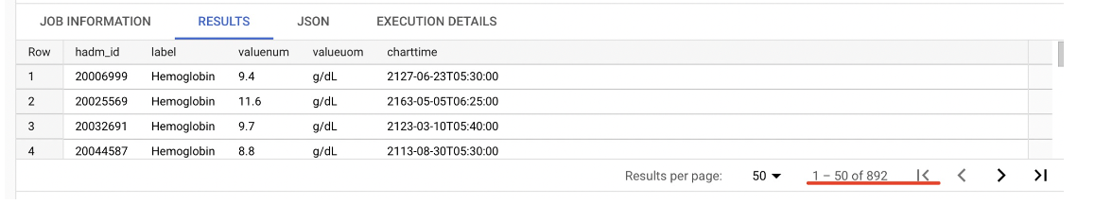
Questions
892 -> 233
Large amounts of patients did not record the Hb before the blood transfusion

Slide 16
Questions
For Q5: what is the difference between the first Hb after a single unit of blood was given and the last Hb before the blood was given in men compared with women ?
How to define a single unit of blood?
Currently we ignore the numeric value of blood was given.
difference between Hb = first Hb – last Hb

Slide 17
Thank you!

